Slide 1
2022 Visioning
Survey Results
Presented By:

Slide 2
WELCOME!!
A Quick Reminder on Process
Review of the Compact for Excellence
Proposed multi-phase process
Phase II: Survey Development ad Data Collection
Community
Staff
Stakeholders
Review the Results
Determine Next Steps – Proceed to Phase III?
Notes:
Four Phase Project:
Phase I: Identifying Outcomes, Expectations and Process Compact
Phase II: Research and Data Collection
Phase III: SWOT Analysis
Phase IV: Creating the Vision
Our agreement covers all phases, however, at the end of each phase, you must decide if you would like to proceed into the next phase of work. After we present the data tonight our Phase II agreement will be fulfilled. Beyond tonight, just let us know how you would like to proceed.

Slide 3
Our Objectives
Receive the information. Ask clarifying questions, allow time to process
Look for themes in the content
Questioning intent, developing solutions, prioritizing projects
Writing the vision statement

Slide 4
What is a Strategic Vision?
A Strategic Vision is an ambitious picture of the future that guides an organization’s strategy.
Common types of strategic visions address:
Economics
Brand
Customer Experience
Quality
Competitive Advantage
Quality of Life
Sustainability
https://simplicable.com/new/strategic-vision

Slide 5
Components of an Effective
Strategic Vision Statement
Future Oriented
Inspiring and Challenging
Motivating and Memorable
Purpose-driven
Unique
“To lead people into a bigger and better future, provide an inspiring, motivating, challenging, memorable, and unique picture of where the business is headed.”
https://lsaglobal.com/blog/5-components-4-criteria-effective-strategic-vision/

Slide 6
What we will NOT be doing!!
Comprehensive planning
Goal setting
Strategic planning
Problem solving

Slide 7
2022 Visioning Survey Results
Survey Response Insights
Notes:
In total 1,161 unique comments, in addition to the charts and graphs were analyzed to bring you these results! Let’s get started!

Slide 8
Survey Response Insights
305 Total Responses
299 Residents
5 Non-residents
11 Businesses
2 Nonprofits
Notes:
Why this doesn’t add up to 305 – because if a business owner was a resident, they could complete both the resident and business survey and it counted as 1 response, the same holds true for nonprofits. However, not all non resident business owners or nonprofit operators completed the nonresident survey.
Actual survey category breakdowns included:
I am a Windsor Heights resident. 94.10% 287
I am a Windsor Heights resident and local business owner/operator. 3.28% 10
I am not a Windsor Heights resident, but I am a local business owner/operator. 0.33% 1
I am a Windsor Heights resident and oversee a local nonprofit. 0.66% 2
I am not a Windsor Heights resident, but I oversee a local nonprofit. 0.00% 0
I am not a Windsor Heights resident. 1.64% 5
Answered 305

Slide 9
Survey Response Insights
How many people did the survey capture?
42 – 1 member households
121 – 2 member households
46 – 3 member households
47 – 4 member households
Minimum of 610 people
256 Households
11% of Households
12% of Population
Notes:
Unique IP address required to complete survey
https://www.census.gov/quickfacts/fact/table/windsorheightscityiowa,iowacitycityiowa/POP815220

Slide 10
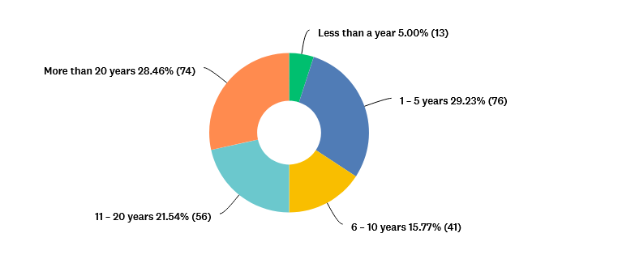
Survey Review
Years Lived in Windsor Heights

Slide 11
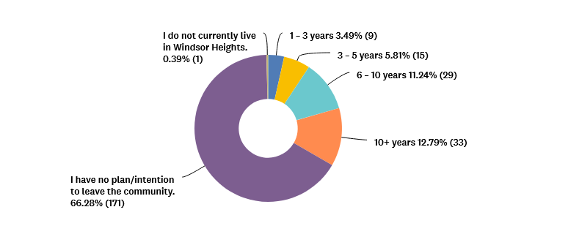
Survey Review
How long do you plan to reside in Windsor Heights?

Slide 12
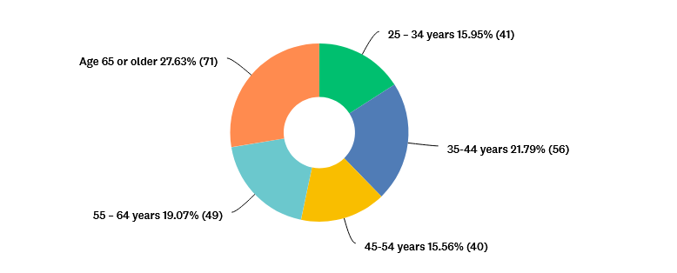
Survey Review
Respondent Age Groups
Windsor Heights Median Age 43.5
38% Survey Respondents
Notes:
https://datausa.io/profile/geo/windsor-heights-ia
Most significant group of survey respondents, 65 and older, not the largest concentration of population - Ages 55 and above reflect 46.7% of survey respondents

Slide 13
2022 Visioning Survey Results
Resident Response Details

Slide 14
Resident Response Details
Q9. All things considered, how satisfied are you with living in Windsor Heights?
CSAT SCORE: 80%
“The American Customer Satisfaction Index (ACSI) measures average CSAT scores across 10 different industries. According to its 2020 data, if you’re scoring over 80% then no matter what industry your business is in, you’re doing really well.”
Notes:
https://blog.hootsuite.com/csat-score/
CSAT Score:
CSAT stands for “customer satisfaction.” So a CSAT score is a customer service metric that reflects customer sentiment, experience and contentment with your brand. It’s a way to qualitatively show how customers perceived their experience with your brand or its products. And because it’s qualitative, it’s a useful Key Performance Indicator (KPI) that your business can track.
The American Customer Satisfaction Index (ACSI) measures average CSAT scores across 10 different industries. According to its 2020 data, if you’re scoring over 80% then no matter what industry your business is in, you’re doing really well. Anything below 60% indicates room for improvement.

Slide 15
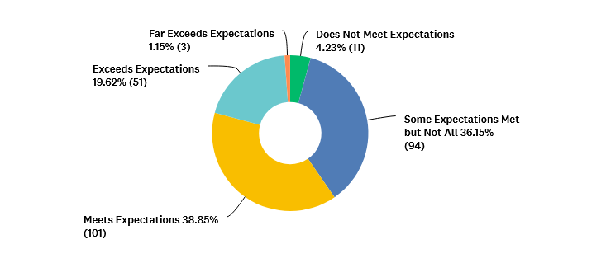
Resident Response Details
Q10. How well is Windsor Heights doing meeting your expectations?
Notes:
248 people responded to this question
Some expectations met but not all and meets expectations account for 75% of all survey responses – very positive! (Total of 187 people)
145 Comments on this question
Primary Themes:
Wanting an increase in Code Enforcement (15 comments)
The community feel is an important part of the experience (18 comments)
Development – excited for Aldis, but concern over the number of grocery stores, desire for more unique shopping and dining options (20 comments)
Safety – concern over excessive speed, noise and general policing (16 comments)
Streets – A lot of interest in street improvement (51 comments)
Sidewalks and Walkability – for the positive! (27 comments)
Concern over the cost of property tax – but all from the over 65 age bracket

Slide 16
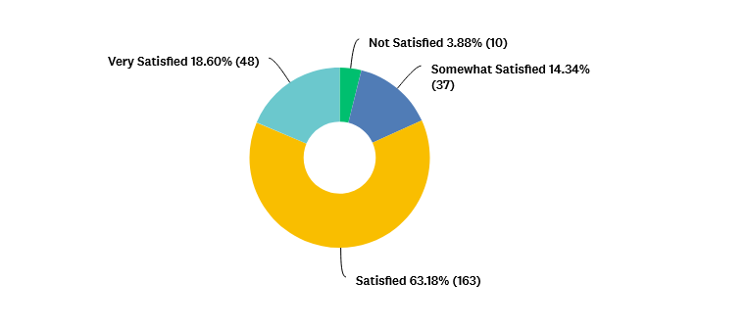
Resident Response Details
Q11. How satisfied are you with services provided by the City of Windsor Heights?
Notes:
258 people responded to this question
211 people were satisfied, or very satisfied with city services! Very positive!
95 Comments on this question
Most interest in:
Streets (32 comments)
Safety (22 comments)
Code Enforcement (10 comments)
Parks & Trails (12 comments)
Garbage & Recycling (10 comments)

Slide 17
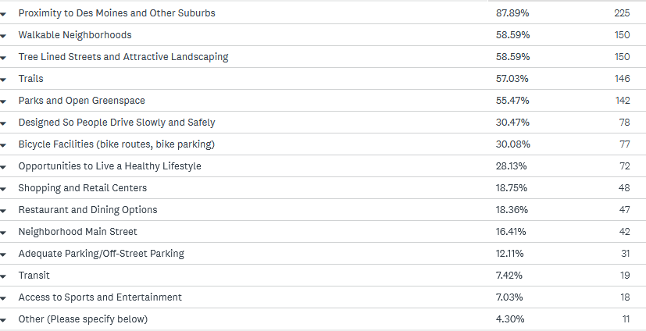
Resident Response Details
Q12. What do you like most about Windsor Heights?
Notes:
256 people responded to this question
52 Comments on this question
Thoughts again focused around:
Development
Location
Neighborhood Feel
Parks & Trails
It’s quiet
Safety
Sidewalks/Walkability

Slide 18
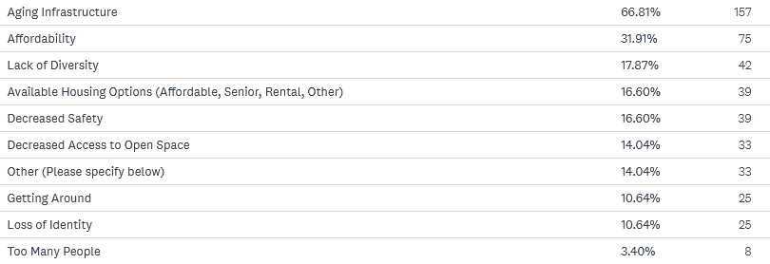
Resident Response Details
Q13. What are your biggest concerns about Windsor Heights as we continue to grow and change?
Notes:
235 people responded to this question
106 Comments on this question
Thoughts receiving the most comments:
Concern over the potential for the increase of property taxes (20 comments)
How to manage the right kinds of development opportunities (11 comments)
Housing – preservation, too many rentals, code enforcement, maintenance (11 comments)
Taking care of and investing in the streets (11 comments)
Sidewalks/Walkability – (10 comments)
Code enforcement continues to be a topic – (9 comments)
Other themes:
Flood control, green space, safety, traffic and transportation

Slide 19
Resident Response Details
Q15. What are the top 5 essential changes you feel are important for Windsor Heights to thrive in the next 10 years?
Improved Streets/Roads 57%
Restaurant/Dining Options 54%
A Connected Sidewalk Network 40%
Greater Diversity of Shopping
and Retail Stores 37%
Improved Parks and Trails 37%
Notes:
254 people responded to this question
66 Comments on this question
Followed by:
Outdoor Spaces – 26%
More Housing – 20%
Public Art – 17%
Increased/Improved Transit – 12%
Welcoming Corridors and Entrances – 10%
Additional Employment Opportunities -7%
Sports and Entertainment areas – 6%
Office Space – less than a %

Slide 20
Resident Response Details
Q16. What amenities do you leave Windsor Heights to access?
Notes:
251 people responded to this question
40 Comments on this question
Common thoughts shared:
Because of our location, we benefit from access to all things
Parks & Trails
Suggestions for dining and shopping
Interest in fitness and health options
Opportunities for partnership
Support for green initiatives

Slide 21
Resident Response Details
Q17. What makes Windsor Heights special?
Location
Small town feel
Neighbors
Size
Housing
Quiet
Parks & Trails
Trees
Development
Events
Notes:
154 people responded to this question
Noted on the slide in order of priority – development and events are actually tied

Slide 22
Resident Response Details
Q19. What thoughts or ideas would you like to share as we work to shape the future vision for the community?
Development
Leadership
Sidewalks/Walkability
Streets
Notes:
115 people responded to this question
Handout with summarized comments to share – handout also includes thoughts from nonresident input as well.

Slide 23
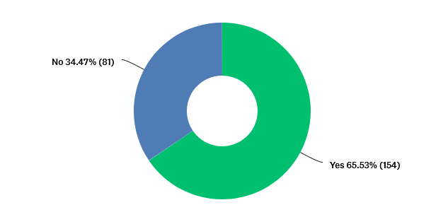
Resident Response Details
Q20. Do you feel like you are getting value for your tax dollar?
Notes:
235 people responded to this question
101 Comments on this question
In evaluating the comments:
44 comments noted concerns about taxes being high compared to the value
25 comments noted they were satisfied or neutral
20 comments noted concerns related to streets

Slide 24
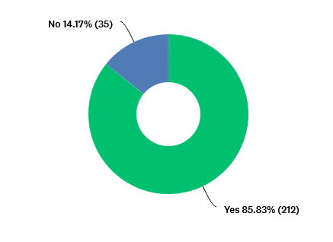
Resident Response Details
Q21. I would encourage others to live in the city of Windsor Heights.
Notes:
247 people responded to this question
73 Comments on this question
In evaluating the comments:
Community feel, location and safety are all important
Housing, taxes, walkability and lack of diversity are concerns

Slide 25
2022 Visioning Survey Results
Non-Resident Response Details
Notes:
Challenge – technically the sample size is very small – the data isn’t a large enough pool to be dynamic.

Slide 26
Non-Windsor Heights Resident Response Details
General Age Groups
25-34 years of age (2 respondents)
35 – 44 years of age (1 respondent)
Size of Household
2 – 2 person
1 – 4+ person

Slide 27
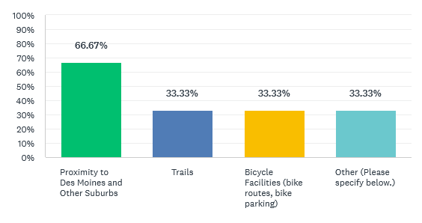
Non-Windsor Heights Resident Response Details
Q25. What do you like most about Windsor Heights?
Notes:
3 people responded to this question
The other indicates lack of walkability

Slide 28
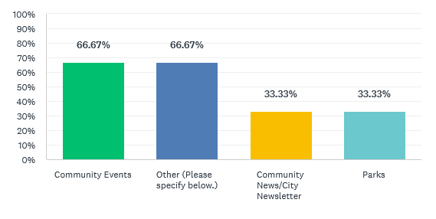
Non-Windsor Heights Resident Response Details
Q26. What makes you feel connected to our community?
Notes:
3 people responded to this question
The other comments include WalMart and Sam’s Club and again, walkability

Slide 29
Non-Windsor Heights Resident Response Details
Q27. What are the top 5 essential changes you feel are important for Windsor Heights to thrive in the next 10 years?
A Connected Sidewalk Network 67%
Increased/Improved Transit 33%
Welcoming Corridors & Entrances 33%
Improved Streets/Roads 33%
Other 33%
Notes:
3 people responded to this question
Lime green indicates shared in common with residents
Other:
Comments noted regard sidewalks and affordable housing

Slide 30
Non-Windsor Heights Resident Response Details
Q28. What makes Windsor Heights special?
Location
Notes:
2 people responded to this question

Slide 31
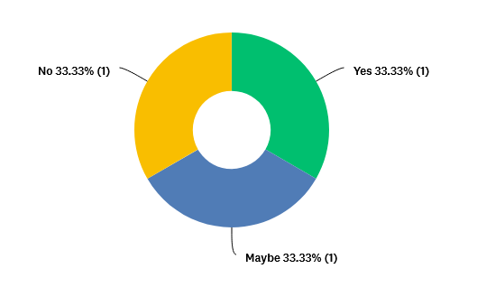
Non-Windsor Heights Resident Response Details
Q29. If you were relocating to the metro area, would Windsor Heights e a community you would consider?
Notes:
3 people responded to this question
In evaluating the comments:
Homes are too outdated for me
Apartment flooded – moved out of WH
Yes - much of Des Moines is unfortunately very un-walkable thanks to red lining and white flight suburban cul-de sac development that saps away from taxpayers.

Slide 32
Non-Windsor Heights Resident Response Details
Q30. What thoughts or ideas would you like to share as we work to shape the future vision for the community?
Sidewalks/Walkability
Notes:
2 people responded to this question
Comments included in handout summary

Slide 33
2022 Visioning Survey Results
Business & Nonprofit Sector Survey Results

Slide 34
Business and Nonprofit Sector Survey Results
13 Total Responses
11 Businesses
10 resident operated
1 nonresident operated
2 Nonprofits
Both resident operated
All business are less than 25 employees

Slide 35
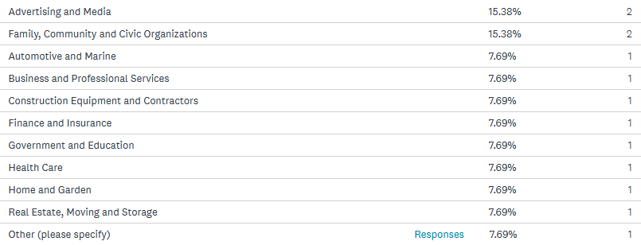
Business and Nonprofit Sector Survey Results
Sectors served by the respondents:
Scale Service
Notes:
Other included: Scale Service

Slide 36
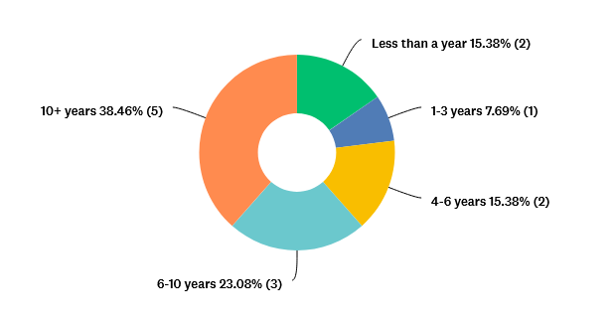
Business and Nonprofit Sector Survey Results
Years in Business

Slide 37
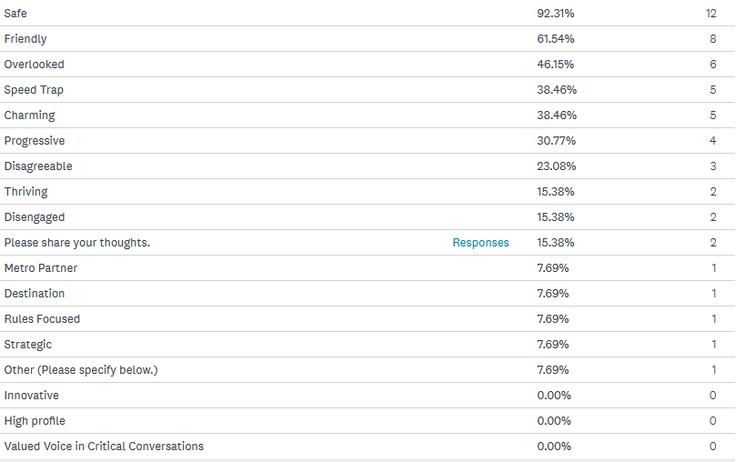
Business and Nonprofit Sector Survey Results
Q5. What words come to mind when you think about Windsor Heights?
Notes:
Other included:
Improve infrastructure
Leadership ambiguity – you sell fireworks to generate revenue, but then deem them illegal

Slide 38
Business and Nonprofit Sector Survey Results
Q6. What makes Windsor Heights unique from the other metro suburbs?
PROS
Community/Small town feel
Location
People take pride
CONS
Lack focal point
Improve police engagement

Slide 39
Business and Nonprofit Sector Survey Results
Q7. Is there anything specific you recommend we “DO MORE OF” or anything we “SHOULD STOP DOING”?
Focus on:
Infrastructure
Maintaining landscaping timely
The positives of Windsor Heights
Improve perception/balance PD neighborhood interactions
Forward thinking
Events/Quality of life

Slide 40
Business and Nonprofit Sector Survey Results
Q8. What advice do you have for the Mayor and City Council?
Promote Windsor Heights activities, events and shops
Keep listening to all perspectives
Recognize generational and cultural shifts
Project investments – it will be difficult to make everyone happy

Slide 41
2022 Visioning Survey Results
Stakeholder Input
Notes:
17 people invited to participate – 7 responses received – response rate 41%
Stakeholders invited to participate:
Russ Trimble, Mayor, City of West Des Moines Russ.Trimble@wdm.iowa.gov
Bob Andeweg, Mayor, City of Urbandale bandeweg@urbandale.org
John Edwards, Mayor, City of Clive jedwards@cityofclive.com
T.M. Franklin Cownie, Mayor, City of Des Moines fcownie@dmgov.org
Matt McQuillen, City Manager, City of Clive mmcquillen@cityofclive.com
AJ Johnson, City Manager, City of Urbandale Ajohnson@urbandale.org
Tom Hadden, City Manager, City of West Des Moines Tom.Hadden@wdm.iowa.gov
Scott Sanders, City Manager, City of Des Moines citymanager@dmgov.org
Elizabeth Presutti, CEO, DART epresutti@ridedart.com
Kevin Foley, Executive Director KJFoley@dsmairport.com
Jay Byers, Pres and CEO, Greater Des Moines Partnership jbyers@DSMpartnership.com
Dr. Matt Adams, Superintendent, West Des Moines Community Schools 515-633-5000
Matt Smith, Interim Superintendent, Des Moines Public Schools 515-242-7911
Robert Brownell, District 1 Supervisor robert.brownell@polkcountyiowa.gov
Ted Corrigan, CEO and General Manager, Des Moines Water Works corrigan@dmww.com
Michael McCoy, Executive Director, Metro Waste Authority mmc@mwatoday.com
Greg Voss, Executive Director, Walnut Creek YMCA greg.voss@dmymca.org

Slide 42
Stakeholder Survey Results
17 Invitations Sent
7 Responses (41% response rate)
2 city managers of a peer cities
4 regional partners
1 school administrator

Slide 43
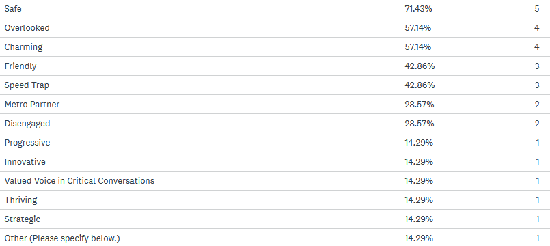
Stakeholder Survey Results
Q1. What words come to mind when you think about Windsor Heights?
Notes:
Other thoughts included:
“When I think of Windsor Heights I immediately think of a fairly safe walking/running/biking environment. The "main street" area along university avenue looks and feel accessible. However, We recently hosted an exchange student and spent a full week showing this high school student around Des Moines. We did not bring this student to Windsor Heights because I'm not aware of there being a specific "attraction" that draws people to that area.”
‘A silo surrounded by a wealth of potential regional partners.”

Slide 44
Stakeholder Survey Results
Q3. What makes Windsor Heights unique from the other metro suburbs?
PROS
Less traffic
Accessible
Easy to get to
Convenient location
Small town feel
Colby Park is a real gem!
CONS
No presence, not at the table like other communities
Unwillingness to collaborate regionally
Landlocked
Notes:
From the Business/Nonprofit Survey:
Pros: Community/small town feel, location, people take pride
Cons: Lack of focal point, improve police engagement

Slide 45
Stakeholder Survey Results
Q4. Is there anything specific you recommend we “DO MORE OF” or anything we “SHOULD STOP DOING”?
Focus on:
Regional collaboration
Events/Quality of life
Notes:
From the Business & Nonprofit Sector Survey:
Focus on:
Infrastructure
Maintaining landscaping timely
The positives of Windsor Heights
Improve perception/balance PD neighborhood interactions
Forward thinking
Events/quality of life

Slide 46
Stakeholder Survey Results
Q7. What advice do you have for the Mayor and City Council?
Foster collaboration with neighboring communities and jurisdictions
Maximize development opportunities
Promote community attractions like Colby Park, and bike trail connectivity
Market! More social media presence

Slide 47
2022 Visioning Survey Results
Staff Input
Notes:
23 of 32 staff participated – 72%

Slide 48
Staff Survey Results
Q1. What are your biggest concerns about Windsor Heights as we continue to grow and change?
Notes:
Other thoughts included:
An emphasis to expand the firefighting/paramedic force
Keeping pace with competitive pay scales
Missed opportunities for development
Resident responses to this question – keeping in mind their answer options were a bit different:
Aging infrastructure
Affordability
Lack of diversity
Available housing
Decreased safety

Slide 49
Staff Survey Results
Q2. What are the top 5 essential changes you feel are important for Windsor Heights to thrive in the next 10 years?
Restaurant/Dining Options 74%
Improved Streets/Roads 43%
Greater Diversity of Shopping
and Retail Stores 40%
Additional Employment
Opportunities 30%
Improved Parks and Trails 26%
Notes:
One additional staff note – 63rd and Hickman
Q15 Resident Response to this question:
Improved Streets/Roads 57%
Restaurant/Dining Options 54%
A Connected Sidewalk Network 40%
Greater Diversity of Shopping
and Retail Stores 37%
Improved Parks and Trails 37%
Q27 Nonresident Response to this question:
A Connected Sidewalk Network 67%
Increased/Improved Transit 33%
Welcoming Corridors & Entrances 33%
Improved Streets/Roads 33%
Other 33%

Slide 50
Staff Survey Results
Q3. What 3 words or concepts would you like to see reflected in the city’s vision statement?
Safe
Friendly
Innovative

Slide 51
Staff Survey Results
Q4. What makes Windsor Heights Special?
Location
Size
Small town feel
Services
From the Resident Survey
Q17. What makes Windsor Heights special?
Location
Small town feel
Neighbors
Size
Housing
Quiet
Parks & Trails
Trees
Development
Events

Slide 52
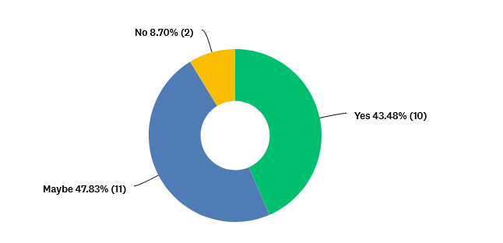
Staff Survey Results
Q5. I would encourage others to work for the city of Windsor Heights.
Notes:
16 comments were received on this question.
In evaluating the comments:
8 (50%) were positive – supporting opportunity at the City of Windsor Heights, the work environment, the teams and feeling valued/appreciated.
5 (31%) share it depends on the position and department as well as impact on elections is always something to contend with.
3 (19%) were negative – again referencing the impact of elections, budget and some team dynamics.

Slide 53
Staff Survey Results
Q6. Is there anything specific you recommend we “DO MORE OF” or anything we “SHOULD STOP DOING”?
Focus on:
Events/Quality of life
Code enforcement
Infrastructure
Streets
Notes:
From the Business & Nonprofit Sector Survey:
Slide 39 - Q7 Focus on:
Infrastructure
Maintaining landscaping timely
The positives of Windsor Heights
Improve perception/balance PD neighborhood interactions
Forward thinking
Events/Quality of life
From the Stakeholder Survey:
Slide 45 – Q7 Focus on:
Regional collaboration
Events/Quality of life

Slide 54
Staff Survey Results
Q7. What other thoughts or ideas would you like to share as we work to shape the vision for the community?
More focus should be placed on efforts for employee recruitment and retention
Opportunity exists to be innovative with development in Windsor Heights!
Keep on this work! It’s important!

Slide 55
Share Your Thoughts!
That is A LOT of data, but what stands out to you?

Slide 56
Next Steps
Finalize the written report
Determine if we proceed to Phase III
Deeper dive into the Data
Potentially Focus Groups
SWOT Analysis
Option A
Option B

Slide 57
“When the VISION is clear, STRATEGY is easy.”
unknown

Slide 58
THANK
YOU!!

